Slide 1
Spring and Spring MVC

Slide 2
MODULE ON Spring Framework
Architecting Your Application with Spring - Spring Basics - Basic Application Setup

Slide 3
Spring Framework
Spring is a lightweight framework. It can be thought of as a framework of frameworks because it provides support to various frameworks such as Struts, Hibernate, Tapestry, EJB, JSF, etc.
The Spring framework comprises several modules such as IOC, AOP, DAO, Context, ORM, WEB MVC etc.
The Spring framework comprises of many modules such as core, beans, context, expression language, AOP, Aspects, Instrumentation, JDBC, ORM, OXM, JMS, Transaction, Web, Servlet, Struts etc.

Slide 4
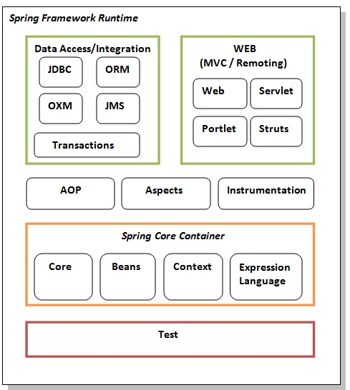
These modules are grouped into Test, Core Container, AOP, Aspects, Instrumentation, Data Access / Integration, Web (MVC / Remoting) as displayed in the following diagram.
Test- Testing with Junit
Spring Core Container
Core & Beans-provide IOC &
Dependency Injection features
Context -supports internationalization
(I18N), EJB, JMS, Basic Remoting
Expression Language
AOP, Aspects and Instrumentation
support aspect oriented programming
implementation where you can use
Advices, Pointcuts etc.
Data Access & Integration
support to interact with the database.
Web
support to create web application

Slide 5
Spring Framework - Advantages
Predefined Templates
Loose Coupling
Easy to Test
Lightweight
Fast Development
Powerful abstraction
Declarative support

Slide 6
Struts vs Spring
Spring MVC is loosely coupled framework whereas Struts is tightly coupled.
Spring's MVC is very flexible. Unlike Struts, which forces your Action and Form objects into concrete inheritance, Spring MVC is entirely based on interfaces.
Clear separation between controllers, JavaBeans models and views that is not possible in Struts.
Struts 2 Actions are initiated every time when a request is made, whereas in Spring MVC the Controllers are created only once, stored in memory and shared among all the requests.
…

Slide 7
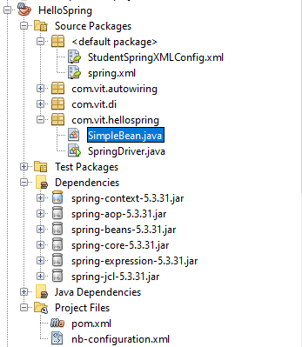
Spring Application Setup
STEPS ARE BASED ON IMPLEMENTATION IN NETBEANS IDE 13
This application uses Maven Build and Annotations
Install Apache Tomcat (We use Version 8.5.76)
Create the Maven project titled ‘HelloSpring’
Add spring jar files (refer ‘Dependencies’)
Create the Bean class ‘com.vit.hellospring.SimpleBean’
Create the spring.xml file under ‘defaultPackage’
Create the Driver class ‘com.vit.hellospring.SpringDriver’

Slide 8
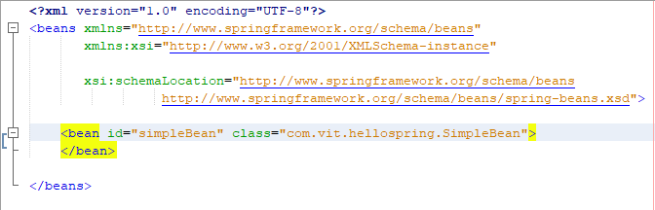
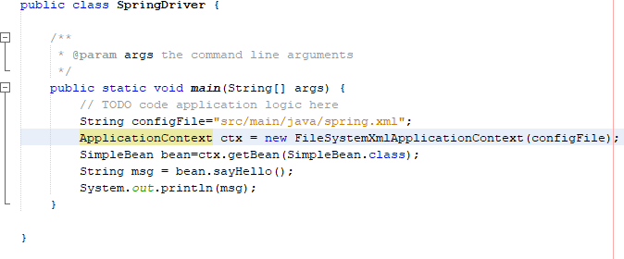
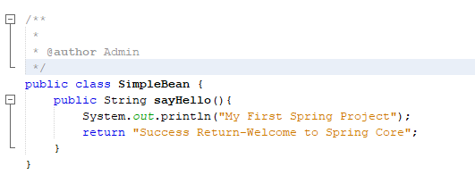
EXECUTION FLOW
Spring.xml
Driver Class
POJO Class
LOAD CONFIG XML
INSTANTIATE BEAN CLASS
Invoke bean method

Slide 9
Inversion of Control (IoC)
Inversion of control (IoC) is the principle where the control flow of a program is inverted: instead the programmer controls the flow of a program, the external sources (framework, services, other components) take control of it.
Inversion of Control is a principle in software engineering by which the control of objects or portions of a program is transferred to a container or framework.
Inversion of Control can be achieved through various mechanisms such as: Strategy design pattern, Service Locator pattern, Factory pattern, and Dependency Injection (DI).

Slide 10
IoC Container
The IoC container is responsible to instantiate, configure and assemble the objects.
The IoC container gets information from the XML file and works accordingly
The main tasks performed by IoC container are:
to instantiate the application class
to configure the object
to assemble the dependencies between the objects
There are two types of IoC containers. They are:
BeanFactory
ApplicationContext

Slide 11
Dependency Injection
Dependency Injection (DI) is a design pattern that removes the dependency from the programming code so that it can be easy to manage and test the application.
Dependency Injection makes our programming code loosely coupled.
Dependency Lookup (DL)
The Dependency Lookup is an approach where we get the resource after demand
Disadvantages
Tight Coupling
Not easy for testing
Through Dependency Injection we provide the information from the external source such as XML file. It makes our code loosely coupled and easier for testing.

Slide 12
Ways to perform DI
Two ways to perform Dependency Injection in Spring framework.
By Constructor
By Setter method
Dependency Injection by constructor
The <constructor-arg> subelement of <bean> is used for constructor injection. Here we are going to inject
primitive and String-based values
Dependent object (contained object)
Collection values etc.

Slide 13
Dependency Injection by constructor
Injecting primitive and string-based values
<constructor-arg value="10" type="int"></constructor-arg>
If you don't specify the type attribute in the constructor-arg element, by default string type constructor will be invoked.
<constructor-arg value="Sonoo"></constructor-arg>
Spring Tutorial Constructor Injection With Dependent Object
<bean id="addr" class="com.vit.dependencyinjection.Address">
<constructor-arg value="ghaziabad"></constructor-arg>
<constructor-arg value="UP"></constructor-arg>
<constructor-arg value="India"></constructor-arg>
</bean>
<bean id="emp4" class="com.vit.dependencyinjection.Employee">
<constructor-arg value="11" type="int"></constructor-arg>
<constructor-arg value="VIT_TEMP"></constructor-arg>
<constructor-arg>
<ref bean="addr"></ref>
</constructor-arg>
</bean>

Slide 14
Dependency Injection by constructor- Contd.
Spring Tutorial Constructor Injection With Collection
A collection can list ,set or map
Each collection can have string based and non-string based values
<bean id="emp5" class="com.vit.dependencyinjection.Employee">
<constructor-arg value="11" type="int"></constructor-arg>
<constructor-arg value="VIT_TEMP"></constructor-arg>
<constructor-arg>
<ref bean="addr"></ref>
</constructor-arg>
<constructor-arg>
<list>
<value>VELLORE</value>
<value>CHENNAI</value>
<value>AMARAVATHI</value>
<value>BHOPAL</value>
</list>
</constructor-arg>
</bean>

Slide 15
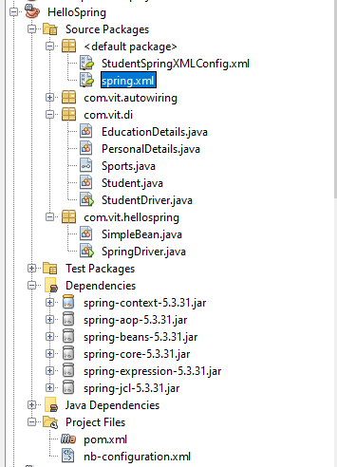
Dependency Injection by setter method
The <property> subelement of <bean> is used for setter injection. Here we are going to inject
primitive and String-based values
Dependent object (contained object)
Collection values etc.
REFER THIS PACKAGE FOR DI PROGRAMS

Slide 16
Spring MVC
It follows the Model-View-Controller design pattern. It implements all the basic features of a core spring framework like Inversion of Control, Dependency Injection.
DispatcherServlet is a class that receives the incoming request and maps it to the right resource such as controllers, models, and views.

Slide 17
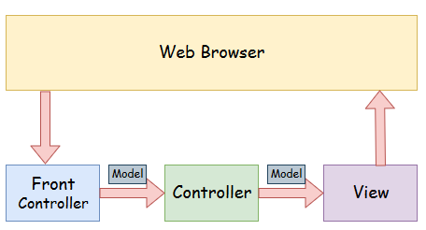
Spring Web Model-View-Controller
Model - A model contains the data of the application. A data can be a single object or a collection of objects.
Controller - A controller contains the business logic of an application. Here, the @Controller annotation is used to mark the class as the controller.
View - A view represents the provided information in a particular format. Generally, JSP+JSTL is used to create a view page. Although spring also supports other view technologies such as Apache Velocity, Thymeleaf and FreeMarker.
Front Controller - In Spring Web MVC, the DispatcherServlet class works as the front controller. It is responsible to manage the flow of the Spring MVC application.

Slide 18
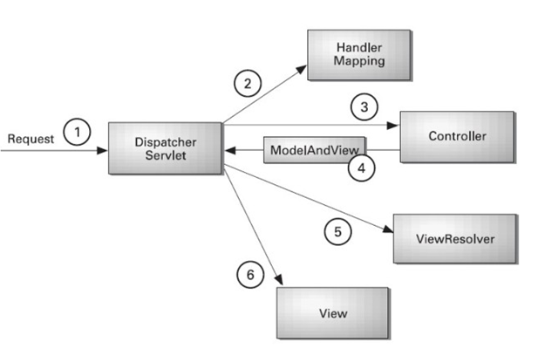
Spring Web MVC Flow
All the incoming request is intercepted by the DispatcherServlet that works as the front controller.
The DispatcherServlet gets an entry of handler mapping from the XML file and forwards the request to the controller.
The controller returns an object of ModelAndView.
The DispatcherServlet checks the entry of view resolver in the XML file and invokes the specified view component.

